Slide 1

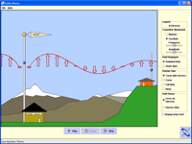





A Balance – Teacher & Researcher
Designing research studies around PhET Interactive Simulations
PhET Interactive Simulations
phet.colorado.edu
Hewlett Foundation
King Saud University
NSF
University of Colorado

Slide 2
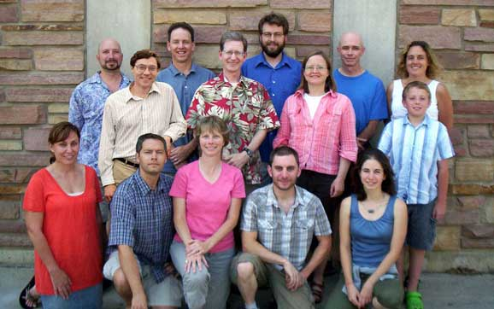
PhET Team
Scientists, teachers, professional programmers

Slide 3
Introduction
Learning Theories
  Constructivism
  Modes of engagement
Why simulations provide a unique environment for learning and research
Examples of research PhET has done
  In class
  Lab
  Types of guidance
Notes:
opposite ends of spectrum

Slide 4
Direct Instruction
First tell how to do problems, then
A train crosses a 100 m bridge at 5 m/s. After crossing the bridge it accelerates at 2 m/s² for 10 seconds to reach its normal cruising speed.
  How long does it take the train to cross the bridge?
  100 m / 5 m/s = 20 seconds
  Just after crossing the bridge, what is the train’s velocity?
    5 m/s
  What is the train’s final velocity?
  V_{f}=v_{o}+ at = 0 m/s + 2 m/s² 10s = 20
  What is the train’s average velocity from the start of the bridge until it reaches cruising speed?
  V_{avg} = (V_{f}-v_{o})/t
Notes:
first telling, then problems like this

Slide 5
Research says….
Found that students do not engage in their homework or laboratories as a scientist would.
  Do not investigate, explore, ask questions, make connections, and deduce the rules.
  Instead they just answer what has been asked
  Transfer and retain little.
Why?
  Students don’t know how to be a scientist?
  Students don’t care? In a hurry.
  Underprepared?

Slide 6

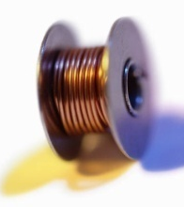



Pure Discovery
Many suggested pure discovery as an alternative.
  Here is a compass, magnet, battery, light bulb and wire. Play with them and figure out how to make the light bulb light and if and how the magnet can affect the light bulb.
  Give grade school students paper, paper clips and a sink full of water. Build a boat that can hold the most paper clips.

Slide 7
Research Says…
Pure discovery students may learn less than with cookbook labs! (Mayer 2004)
  Memory overload, confused without directions, frustrated, lots of false starts.
  Students don’t know what is important or what they have learned.

Slide 8
Learning Theories
Constructivism - Students need a framework of the main ideas to build knowledge on. (Bransford et al 1999)
An active process where students are active sense makers – cognitive not behavioral.
  Direct Instruction - no framework
  Pure Discovery - about 500 years
  Cognitive load (Sweller)
  Contrasting Cases
Notes:
stop for questions

Slide 9
Learning Theories
Performance Mode vs. Learning Mode (Dweck)
  Set of problems at their level
  Set of problems just out of reach
  Reaction depends on their view of intelligence
Math frame versus sense making frame (Bing & Redish)
Motivation. What is the game?
  The way the problem is set up determines the mode students engage in.
Notes:
stop for questions

Slide 10
Unique Environment for Learning and Research
Researcher
  Common Visualization & probe into student brain
    “See” student thinking
    Watch student actions even if quiet
  Common Vocabulary
    Students use words from the sim
    Student shows what the words mean to them
    If students don’t know the word, they use the sim to show the interviewer what they mean.

Slide 11
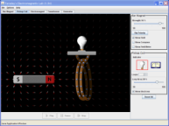
Unique Environment for Learning
Student
  Fun and Engaging (not too fun!)
  Interactive and animated (simulate real equipment)
  The Invisible is Visible
  Multiple Representations (macro & microscopic, graphs, math, counters etc…)
  Minimal Guidance (text, external), but nonzero!
  Balanced Challenges – little puzzles and clues
    attainable, build up to understanding the underlying concept.
Notes:
i cut out bunch of words, added nonzero!

Slide 12
Unique Environment for Learning
Student
  Exploration via their own questioning
  Look for what is missing and investigate
  Development of Expert-like Framework
  Knowledge has more connections and common visualization
ideal for all learning

Slide 13
What are your research questions?

Slide 14
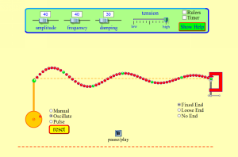
Lecture (Non-science Majors Course)
Wave-on-string simulation vs. Tygon tube demo
Follow-up Concept Test:
Two questions were asked about the velocity of different points on the string.
A
snapshots at
different times
B
C

Slide 15
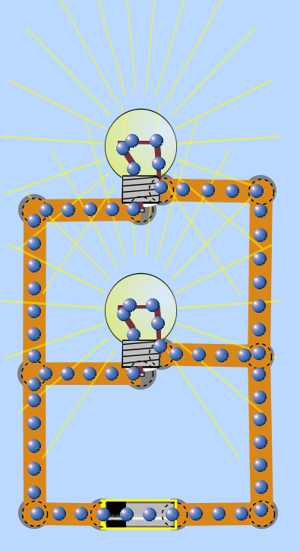

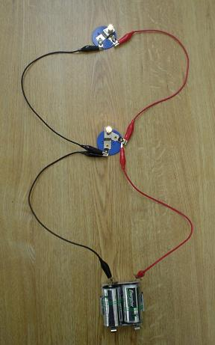
Lab (Algebra-based Physics)
Simulation vs. Real Equipment
vs.
p < 0.001
Finkelstein, Adams, Perkins, Keller

Slide 16
Lab (Algebra-based Physics)
Build a circuit with REAL equipment.
Explain what happens when you create a break and why?

Slide 17
Lab (Algebra-based Physics)
Build a circuit with REAL Equipment
Timing
25
20
15
Time (min)
10
5
0
CCK
Tradtl

Slide 18
Lab (Algebra-based Physics)
How do they feel about it? (“Affective”)
Traditional
Many questions, TAs cannot keep up!
Nervous about getting electrocuted or damaging the equipment.
Looking for the correct answer ONE time.
CCK
Minimal questions – TA spent most of their time watching.
Trying all sorts of different configurations and discussing what might happen.
Question their physics if sim shows something different than they expect.

Slide 19
Quantum Mechanics Course
“I definitely not only enjoyed the simulations, but I'd go as far to say that the simulations taught me the most about the course because I could really visualize the inner workings of the physics processes that were going on.”
“I thought the simulations were great. It helped me to gain intuition about the topic. This is especially useful in quantum mechanics where it is not normally possible to directly observe the described phenomena.”
Notes:
cut to save time

Slide 20
Student Comparisons
New study – TWO years later!!
2 separate labs
  1st used CCK
  2nd week real equipment
Students asked to compare the two labs – N~300
  Sim better for usage 64%
  Preferred Real 22%
  Liked Both 42%

Slide 21

Simulation Interviews
Think-aloud style
  Does not mean ask student what they think of the sim!
Minimal guidance - limited to 1 or 2 conceptual questions.
  Prediction – open conceptual question(s)
  Play
  Revise prediction
30 to 60 minutes per simulation
4-6 interviews per version of sim
  20+ for specific projects
300+ with over 100 students

Slide 22
Minimal Guidance
Goes against our instincts…
We know pure discovery doesn’t work!
Why does minimal guidance work?

Slide 23

Appropriate Scaffolding applies to all learning
Simulations provide scaffolding of the material.
  Students see only the parts needed to understand and build a mental framework.
  Controls are limited to features that affect the phenomena.
  Contrasting cases (analogies) are provided.

Slide 24
Levels of Guidance in Interviews
Guided
Gently Guided (GG)
Driving Questions (DQ)
No instruction

Slide 25
Gently Guided (GG)
Before opening the Sim:
“Can a magnet effect an electron?”
“What are some ways you can make a magnet?”
Open the sim:
1. In the “Bar Magnet” tab, identify the things on the screen and in the controls in the control panel (at the right.)
  What does the “Strength” slider do?
  What does the “Field Meter” do?” …
2. Go to the “Pickup Coil” tab. Identify the things on the screen and in the control panel.
  a. How does motion of the magnet affect the electrons in the coil of wire?
Notes:
question to audience-- seem reasonable to you?? Then lets see how it works.

Slide 26
Driving Questions (DQ)
Open Conceptual Questions
Before opening the sim
“Can a magnet effect an electron?”
“What are some ways you can make a magnet?”
Open the sim:
“Play with everything and talk aloud as you do this.”

Slide 27
GG DQ
8 students
Student Mode:
  Students answer question and wait for the next.
“OK, continue?”
“Is that sufficient for 2”
  Limited framework dev. Often don’t tie pieces together.
  If forget to mention crucial part of the sim, students miss it.
4 students
Engaged Exploration:
  Explore via their own questioning
“Oh, I wasn’t expecting that”
“I was looking around to see if it was an effect of having more wires.”
  Must be open conceptual type questions

Slide 28
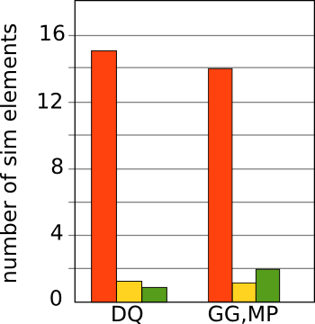
What did students notice?
Elements mentioned in the GG activity.
Explored
Just noticed
Not noticed

Slide 29
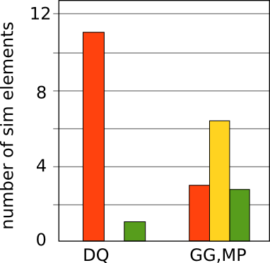
What did students notice?
Elements not mentioned in the GG activity.
Explored
Just noticed
Not noticed

Slide 30
Missing Pieces (MP)
With GG activity students were in “student mode”. If something wasn’t mentioned, they didn’t explore it.
To test this we created a Missing Pieces (MP) activity.
  Two questions were omitted from the GG activity
  Three sim elements were mentioned in these two questions.

Slide 31
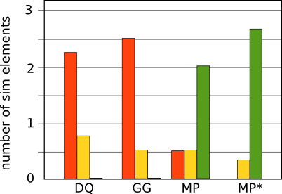
What did students notice?
Missing Pieces (MP)
Elements omitted from the GG activity.
Explored
Just noticed
Not noticed
MP* - Anomalous student removed.

Slide 32
Research says….
Found that students do not engage in their homework or laboratories as a scientist would.
  Do not investigate, explore, ask questions, make connections, and deduce the rules.
  Instead they just answer what has been asked
  Transfer and Retain little.
Why?
  Students don’t know how to be a scientist?
  Students don’t care? In a hurry.
  Underprepared?
Notes:
are following the rules as they see them

Slide 33

Conclusion
phet.colorado.edu
Mental Framework
  Implicit scaffolding and contrasting cases in the simulation – Balanced Challenges
  Explore items they were ready to learn about
Engaged Exploration
  Open Conceptual questions
    Explore via their own questioning
    Scientist-like exploration
Provide scaffolding
phet.colorado.edu
Notes:
`

Slide 34
Workshop Goals
To Incorporate research and teaching so that work on each compliments the other.
Our Goals for today:
Provide ideas on how sims can be used (lecture, homework, lab, in-class activities).
Familiarity with 4 mainstream U.S. physics journals.
Ideas about useful diagnostic tools and type of data that can show effectiveness of implementation.
Start conversations with colleagues and provide resources
Identify a project(s) for the next year with possible collaborator.

Slide 35
Journal Activity I:
What is different about each?
What can go in each?

Slide 36
Journal Activity I:
Compare:
The Physics Teacher
American Journal of Physics
PER Conference Proceedings
Physical Review Special Topics
WG

Slide 37
Journal Activity II:
Compare research questions/data
Where would your ideas fit?
Discuss things already tried in your course(s).
Think about something done that could be written up.
Test your ideas out on your partner?
  If it’s interesting to your partner and they are very curious about the details, that’s a good sign that it’s interesting enough to write up.

Slide 38
Evidence
What evidence do you have that your project worked?
What evidence do you wish you collected?
How can you get this next time?
What Journal can it go in …
right now?
after you have the data that you want?

Slide 39
What could you publish?
Examples of articles for each journal
WG

Slide 40
Create a study
Think about a possible study to incorporate PhET sims.
  Either new sims and/or in a new way.
What is your research question?
What do you expect the sim to do for the students or for you?
What data will you collect to measure the impact?
Collaborate if possible – e.g. Each do it at your institution and then compare results.

Slide 41
Sim study ideas
What is the research question?
What will it accomplish?
What is the evidence?
WG

Slide 42
Gently Guided (GG)
Archie Paulson crafted the activity through a series of a eight interviews using the simulation.
The goal was to help the students play with all objects necessary to learn about Faraday’s Law.

